Slide 1
Generative Model-Based Testing on Decision-Making Policies
Zhuo Li
Kyushu University, Fukuoka, Japan
ASE 2023

Slide 2



Importance of Testing Decision-Making Policies
DNN-based decision-making policies require more effective test.
Methods for solving decision-making problems have garnered much attention in various fields related to artificial intelligence (AI)
An urgent and critical need to develop software engineering techniques to ensure the reliability of decision-making policies.
The objective is to test decision-making policies by exploring scenarios that lead to execution failures.
Notes:
This is the outline of my presentation, mainly include my master thesis and the doctoral research proposal.

Slide 3
Challenges in Testing Decision-Making Policies
DNN-based decision-making policies are hard to test.
Most decision-making policies employ DNN models
- which are black-box and hard to test.
The infinite state space
- is impossible to be exhaustively tested.
Existing testing methods might be ineffective:
- some methods mutate the intermediate states in a trajectory to explore the failures. (break the continuity of trajectory)
- some methods search the cases which violate predefined metamorphic relations. (requires domain knowledge)

Slide 4
Our Motivation on Testing Decision-Making Policies
We need diversity of the test results, and effectiveness of the method.
Diversify the agent behaviors:
- executing similar test cases tends to exercise similar agent behaviors;
- diverse test cases could increase the exploration of the fault space;
Develop an effective testing method to adapt more test scenarios:
identifying potential failures efficiently and accurately;
effective test cases detect corner cases and increase the possibility of identifying severe vulnerabilities.

Slide 5
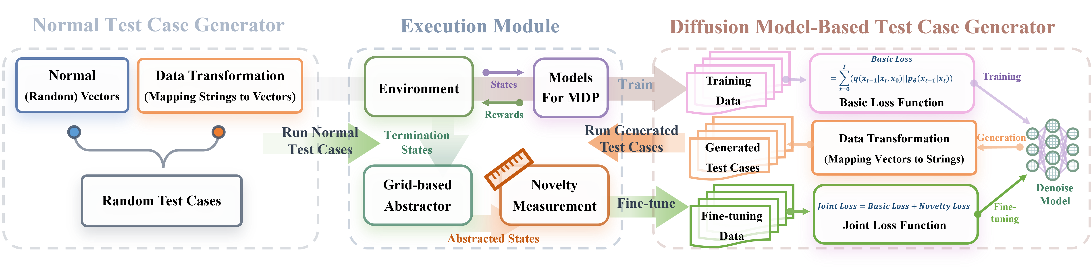
Our Method: An Overview
Method: diffusion model + novelty-based guidance
We introduce novelty-based guidance to measure the freshness of the trajectories.
Our method operates in two phases:
(1) train the diffusion model to scale the test case distribution;
(2) fine-tune the diffusion model to generate test cases which induce diverse agent behaviors.

Slide 6
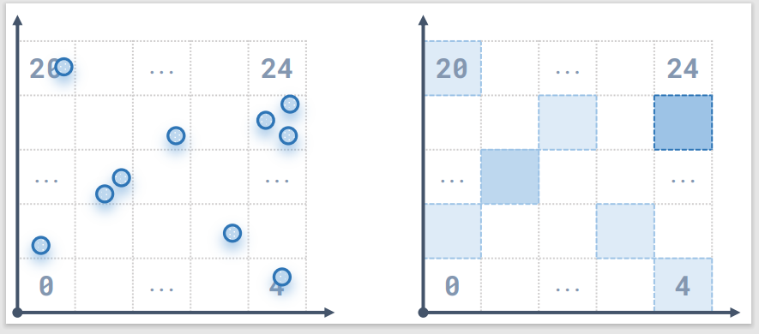


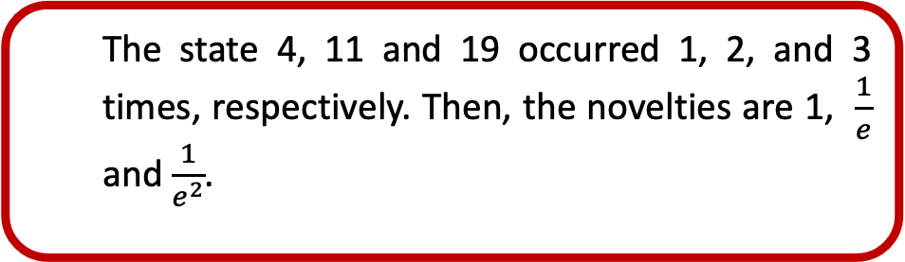
Our Method: Novelty-Based Guidance
How to measure the diversity of agent behaviors? ------ Novelty
We abstract the concrete state spaces into equal grids.
Each grid is an abstract state.
The novelty is measured by the visits of abstract states:
Higher visits -> Lower novelty
Lower visits -> Higher novelty
We represent the trajectory (behavior) diversity by the termination state novelty.
19
11
The state 4, 11 and 19 occurred 1, 2, and 3 times, respectively. Then, the novelties are 1, $\frac{1}{e}$ and $\frac{1}{e^{2}}$.

Slide 7
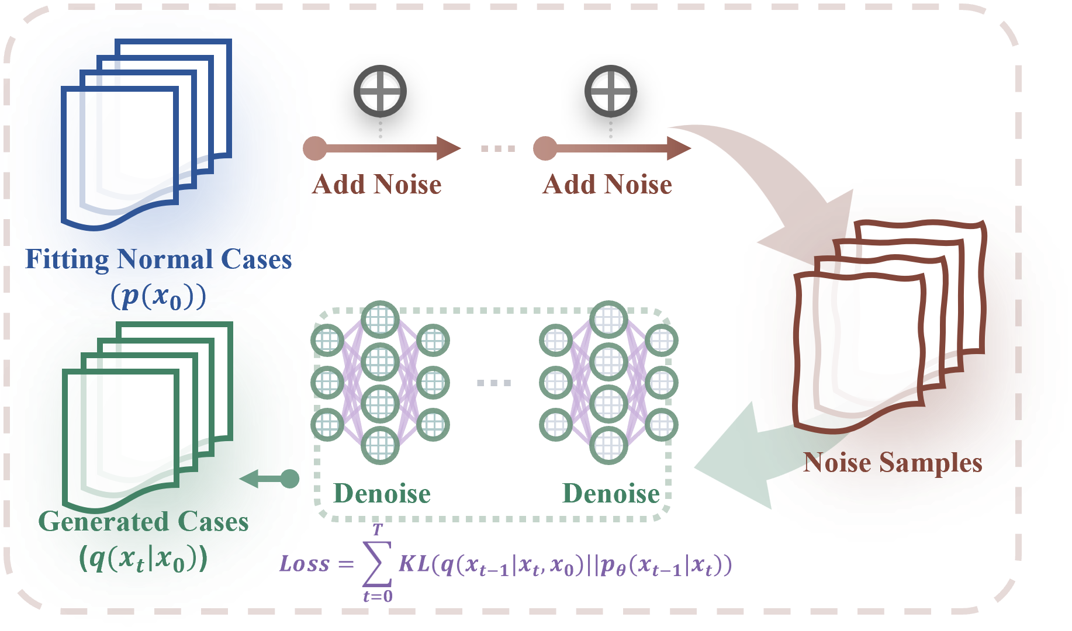


Our Method: Diffusion Model-Based Test Case Generator
Diffusion model: Input = random noises, output (generation) = new test cases.
Diffusion models are representative generative models. Diffusion model-based test case generator follows an encoding-decoding workflow:
Add noise to the test cases
Recover the noise sample back to test cases
Diffusion model-based test case generators learn the correspondence and transformation relationships:
- Gaussian noisy samples <-> test cases.
We bind the novelty-based metrics with the loss function of diffusion models.
We encourage the diffusion model to fit test cases that induce the termination states with high novelties.

Slide 8
Experiment: Research Questions
RQ1: Numbers of detected failures.
RQ2: Novelty vs other guidance (density, sensitivity, reward, etc.)?
RQ3: Diversity of detected failures.
RQ4: Repairing based on the detected failures.

Slide 9
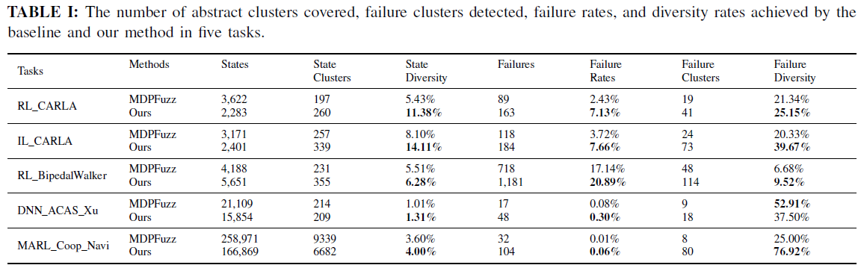



Experiment: RQ1 Detected Failures and RQ3 Diversity of Detected Failures
Our method is more efficient in detecting failures than the baseline method.
Our method surpasses the baseline method in covering a broader range of states and failures within the given number of test cases.
$$s :state | s_{∗} :state with failures |\hat{ s} :abstract state | {\hat{s}}_{∗} :abstract state with failures.$$

Slide 10
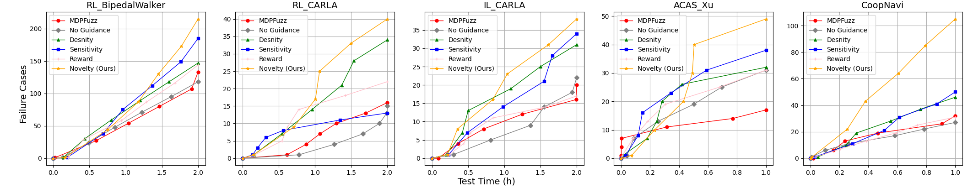
Experiment: RQ2 Novelty vs Other Guidance
Our method with novelty-based guidance detects the most failures.
Our method achieves the highest number of detected failures.
Novelty is the best guidance for improving the test efficiency.

Slide 11
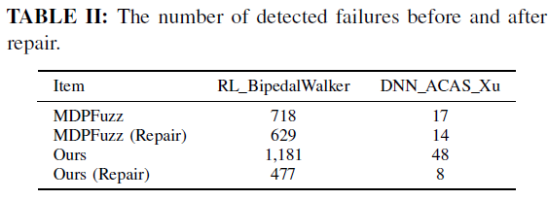
Experiment: RQ4 Robustness Improvement By the Detected Failures
The robustness improvement proves the high quality of our detected failures.
The failure cases detected by our method can help improve the robustness of decision-making policies.
Additionally, repairing evaluated models using our detected failure cases leads to a more significant improvement in robustness compared to the baseline method.

Slide 12
Conclusion & Future Work
Conclusion
Our experimental results demonstrate that our method outperforms baseline techniques in detecting a wider range of failures and enhancing policy robustness.
We show that diversifying agent behaviors can help effectively test decision-making policies.
Future Work
Our future work involves continuously enhancing our method to test and improve decision-making policies:
expanding our techniques to address increasingly complex and safety-critical tasks;
investigating novel guidance strategies to discover more corner failures;
conducting more effective robustness enhancements for existing decision-making policies.

Slide 13


KYUSHU UNIVERSITY
Thank you for listening!
Zhuo Li
2023/9
Notes:
Thanks for the listening, this is all of my presentation.

